Slide 1
Validation and Verification
Software Engineering
Neil Toporski

Slide 2
1. Validation vs Verification[Outline]
Validation vs Verification
Verification and Validation Testing
3Q’s Sequential Approach

Slide 3
1.1 What is Verification and Validation?
Validation is the process of evaluating the final product to check whether the software meets the business needs. Are we building the right product?
Verification is the process of evaluating the intermediary work products of a software development lifecycle to check if we are in the right track of creating the final product. Are we building the product right?
Notes:
Validation – client needs
Verification – operational (coding)

Slide 4
1.3 Verification and Validation Testing
Methods of Verification | Methods of Validation
Verifying documents, design code and program. | Prepare the test requirements documents, test cases, and other test specifications to evaluate the final product.
Design Verification involves reviews of all the design documents including high-level and low-level design. | Evaluate that these test requirements, test cases, and other specifications reflect the requirements and is fit for use.
Code verification includes Code review. | Test for boundary values, stress, and the functionalities.
Checks “Are we building the product right”? | Checks “Are we building the right product”?
Checks whether the product is built as per the specified requirement and design specification. Done before Validation. | Evaluates the final product to check whether it meets the business needs. Is the software ready for consumption by the users?

Slide 5
Components of the Validation Plan
Description of the project
Include all the functionalities
Understanding the requirements
Develop metrics for test case
Test case
A set of actions performed on a system to determine if it satisfies software requirements and functions correctly
How the test case will be carried out
Report (Validation Document)
Notes:
Functional and nonfunctional requirements
Metrics for test cases (document)

Slide 6
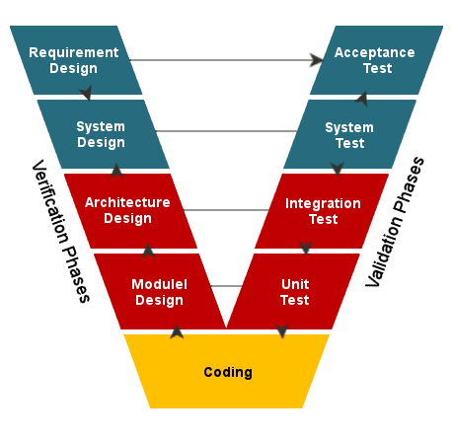
V Model
V model is also known as verification and validation software model is an SDLC (system development life cycle) and STLC (software testing life cycle) based where main execution process takes place in a sequential manner of v shape.
V model is nothing but the extension of the waterfall model.

Slide 7
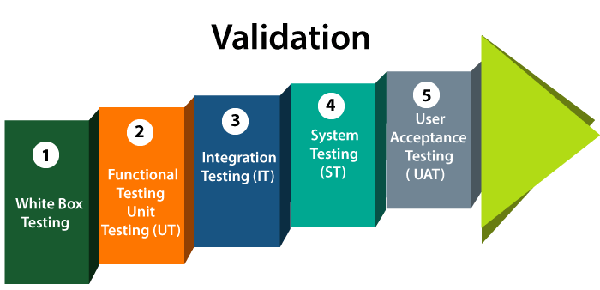
Verification and Validation Testing
Example:
For a functional mobile phone, the main parts (the system) required are “battery” and “sim card”.
Unit testing Example – The battery is checked for its life, capacity and other parameters. Sim card is checked for its activation.
Integration Testing Example – Battery and sim card are integrated i.e. assembled in order to start the mobile phone.
Functional Testing Example – The functionality of a mobile phone is checked in terms of its features and battery usage as well as sim card facilities.

Slide 8
Unit (White Box)Testing (don’t forget to comment)
Unit Testing: It is often the first type of testing done on an application. Unit Testing is performed on each unit or block of code as it is developed. Unit Testing is essentially done by the programmer. As a software developer, you develop a few lines of code, a single function or an object and test it to make sure it works before continuing Unit Testing helps identify a majority of bugs, early in the software development lifecycle. Bugs identified in this stage are cheaper and easy to fix.
Notes:
Snip of code – is it right for what kind of code you want to develop?

Slide 9

Functional Testing
Functional testing tests and describes if the product is compliant with the business/functional requirements of the client: 1) Create input cases, 2) Execute test cases, and 3) Compare actual with expected results.

Slide 10
Integration Testing
Integration testing is done to test the modules/components when integrated to verify that they work as expected i.e. to test the modules which are working fine individually does not have issues when integrated.

Slide 11
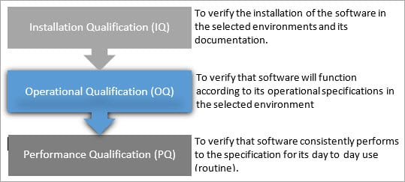
3Q’s Approach: IQ-OQ-PQ
Notes:
OQ – functional requirements
PQ – nonfunctional requirements

Slide 12

3Q Sequential
Ideally, IQ, OQ, and PQ are the sequential activities, which need to be executed in the order.
Unless the installation is done, a functionality of the software cannot be verified and unless the functionality is proven, no point in measuring the performance.

Slide 13
Installation Qualification (IQ)
Installation qualification also referred as ‘IQ’, is the process of validating if the supplied software can be successfully installed on the specified (production) environment with the specified configurations, and to verify how these installation steps are recorded in the document called ‘Installation Guide’.
Notes:
Installation guide – part of user manual

Slide 14
Operational Qualification (OQ)
The Operational qualification activity includes the tests to be run in order to verify that the software is operationally fit to be deployed to the consumers. Ideally, the key functionalities of the software are verified as part of this validation process.

Slide 15
Performance Qualification (PQ)
The key aspect of PQ is to ensure that a software, when installed on the expected system, can handle the live load and meet the expected response time and does not crash under the peak loads and stress while handling concurrent users.
Performance
Responsiveness
Load Balance

Slide 16
3Q’s Matrix
IQ | OQ | PQ
To verify the process of software installation and how the process is documented | To verify the proper functioning of the system | Customers, Owners, Vendors, Operations team

Slide 17
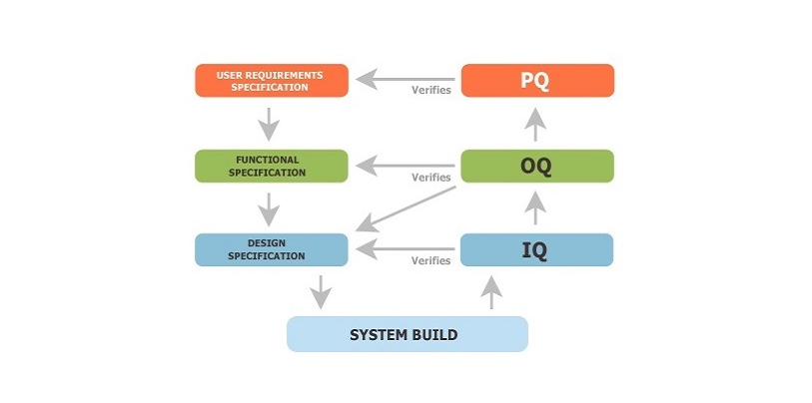
3Q’s “V” Model

